Slide 1
Benchmarking the Bruck Algorithm for All-to-All Communication in multi-GPU environments using NCCL
ERROR Workshop 2023 Andres Sewell Computer Science Department Utah State University

Slide 2
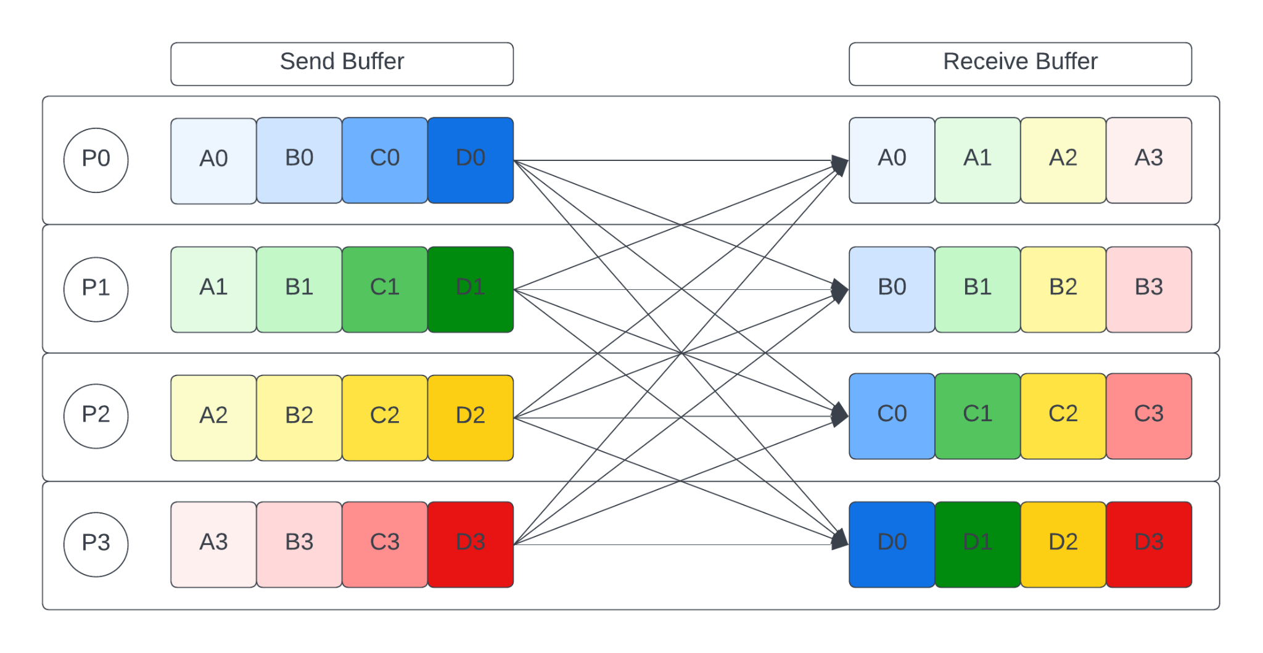
Motivation: What is All-to-All communication, where is it used?
In distributed …
Algorithms
Sorting, graph theory, linear algebra, relational algebra, etc.
Scientific Simulations
NekRS, SPARTA, LAMMPS, etc.
Machine Learning
PyTorch
Visual example of how the All-to-All communication pattern distributes data among processes.
Notes:
Explain that all-to-all communication is used in distributed computing.
Briefly mention the examples and highlight that the distributed algorithms get incorporated in various types of simulations.
Refer to the diagram, mention that each process sends a portion of its data to every other process.

Slide 3
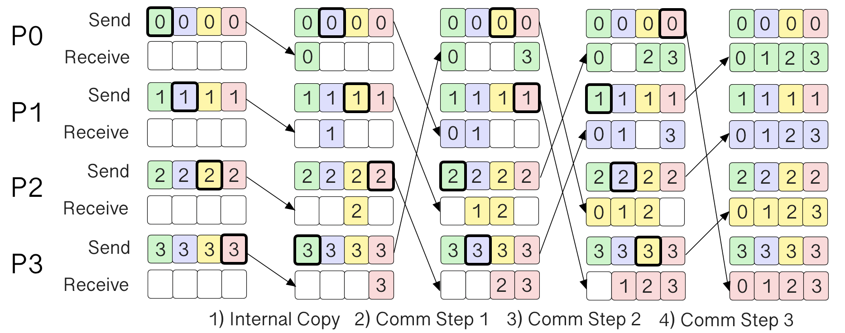
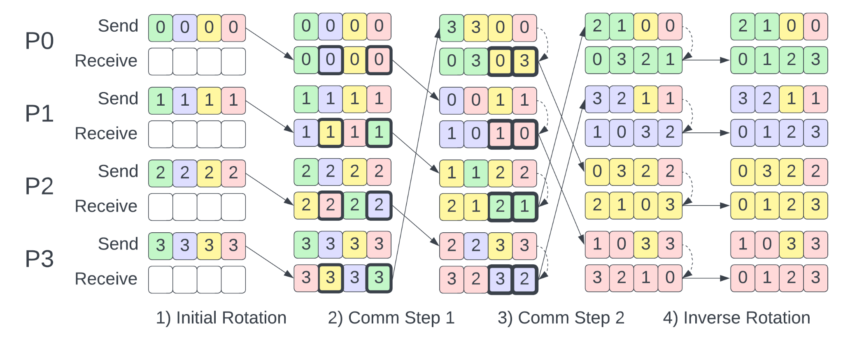
Background: Spread-out vs Bruck Algorithm Comparison
 | Spread-out | Bruck
Communication steps per process p | O(p) | O(log₂(p))
Data transmitted per step | Relatively less: (data / p) | Relatively more: (data / log₂(p))
Ideal circumstances | Computation-bound Relatively small p Large messages (> 2KB) | Communication-bound Relatively large p Small messages (< 2KB)
Notes:
Most popular algorithms

Slide 4
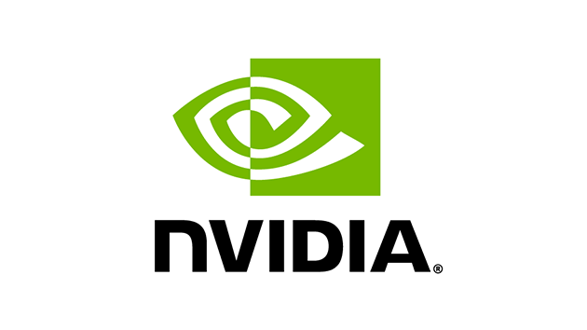
Background: All-to-All Communication for CPUs and GPUs
Message Passing Interface (MPI)
Protocol that facilitates communication in distributed settings.
Several implementations exist: OpenMPI, MPICH, and vendor-optimized MPI.
NVIDIA Collective Communications Library (NCCL)
Library for performing MPI-style distributed communication across many NVIDIA GPUs.
Uses direct GPU to GPU communication.
OpenMPI logo credit: http://www.open-mpi.org/
NVIDA logo credit: https://www.nvidia.com/en-us/about-nvidia/legal-info/logo-brand-usage/
Notes:
Some background on what MPI and NCCL are. The audience is probably well acquainted with MPI but less familiar with NCCL.

Slide 5
Background: Important Differences Between MPI and NCCL
MPI
Provides uniform and non-uniform All-to-All implementations via MPI_Alltoall and MPI_Alltoallv respectively.
MPI-based Bruck has been shown to be optimal in communication-bound scenarios.
NCCL
NCCL communication require GPU kernels launches (which have inherent overhead).
Implementation of collectives are proprietary. No study has been done to assess performance of all-to-all using different algorithms.
NVIDIA suggests using a for loop of send and receive operations:
Has the concept of NCCL groups, used to:
Aggregate communication operations
Merge multiple send/receive point-to-point operations
Progresses asynchronously if communication is independent
Optimizing the Bruck Algorithm for Non-uniform All-to-all Communication https://dl.acm.org/doi/abs/10.1145/3502181.3531468 NCCL Group info https://docs.nvidia.com/deeplearning/nccl/user-guide/docs/usage/groups.html
NCCL All-to-All implementation https://docs.nvidia.com/deeplearning/nccl/user-guide/docs/usage/p2p.html?highlight=all%20all#all-to-all

Slide 6
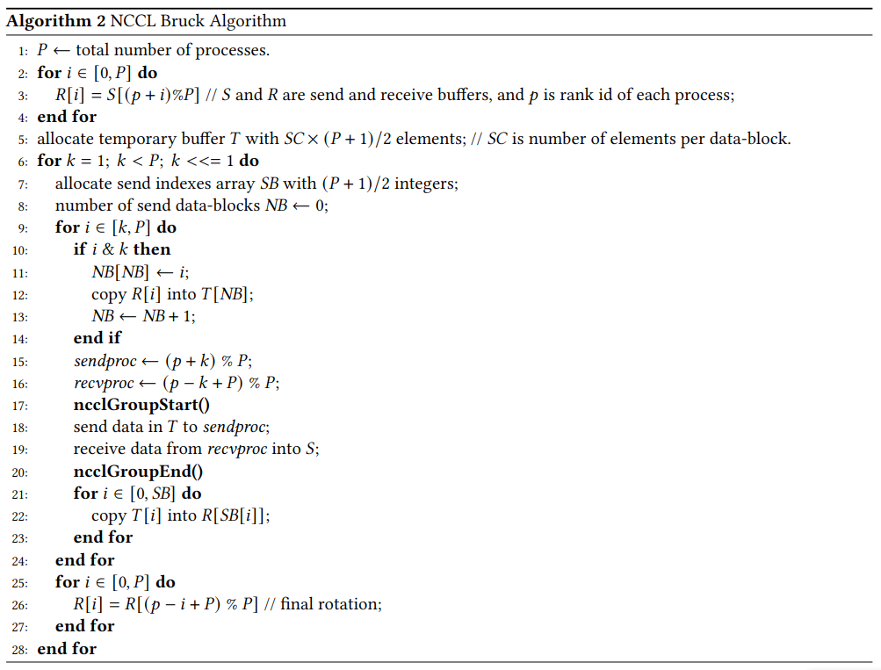
Continued: Bruck Implementation Using NCCL
Notes:
Bruck algorithm works in phases and the communication has to happen in a particular order
Highlight the send and receive calls and the loop that contains them
We cannot have a single nccl group contain all the calls because NCCL will enforce the ordering as we expect

Slide 7
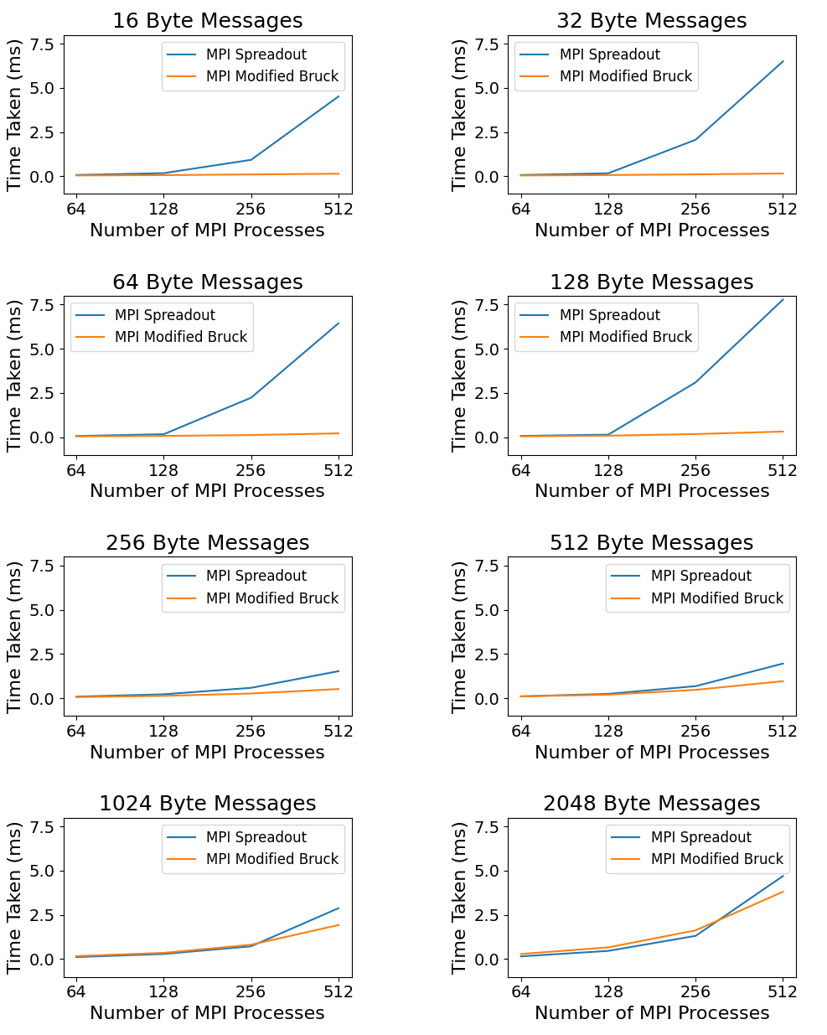
Weak Scaling Study Using MPI-Bruck
Results:
MPI-based Bruck is optimal in communication-bound scenarios.
The default NCCL All-to-All appears to use Spread-out.
We hypothesized that NCCL-based Bruck would also perform optimally in communication-bound scenarios.
Note: results shown were collected using the Polaris supercomputer at the Argonne Leadership Computing Facility.

Slide 8
Benchmark Methodology
Implement a NCCL version of the Bruck algorithm.
Incorporate NCCL-Bruck into the official nccl-tests benchmark.
Measure scaling performance of both the default All-to-All and our Bruck implementation on Polaris and ThetaGPU (Argonne National Lab).
Use message sizes between 16 and 2048 bytes, the range where we would expect Bruck to perform best.

Slide 9
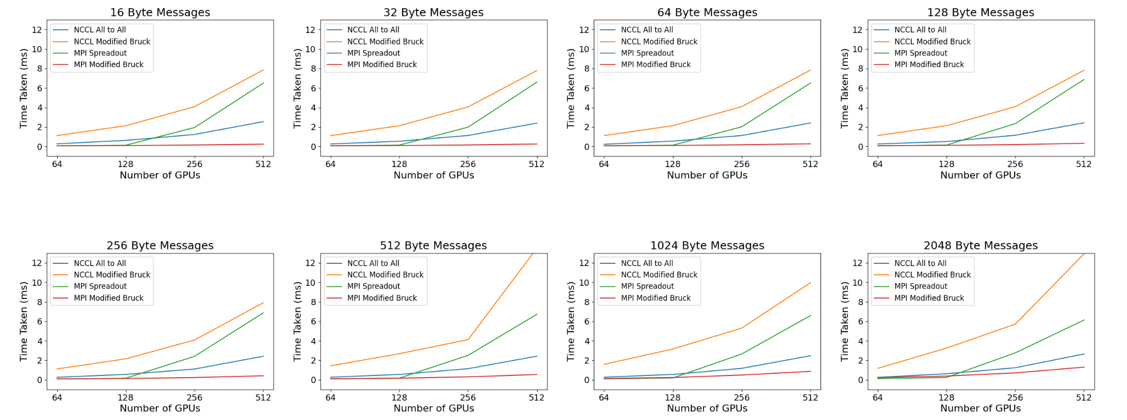
Results: Weak Scaling Study Comparing All-to-All Performance
Note: results shown were collected using the Polaris supercomputer at the Argonne Leadership Computing Facility. Similar results were also observed on the Theta-GPU supercomputer.

Slide 10
Conclusions
When communicating small message sizes in multi-GPU settings, it is faster to use MPI-based Bruck.
The default NCCL All-to-All fits entirely into a NCCL group. Bruck communication is dependent, and therefore can’t fit entirely into a NCCL group.

Slide 11
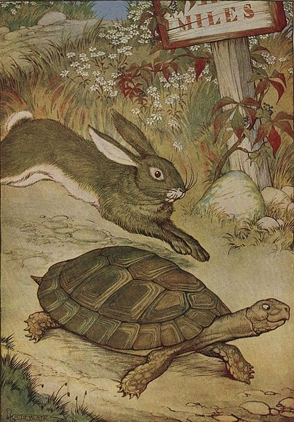
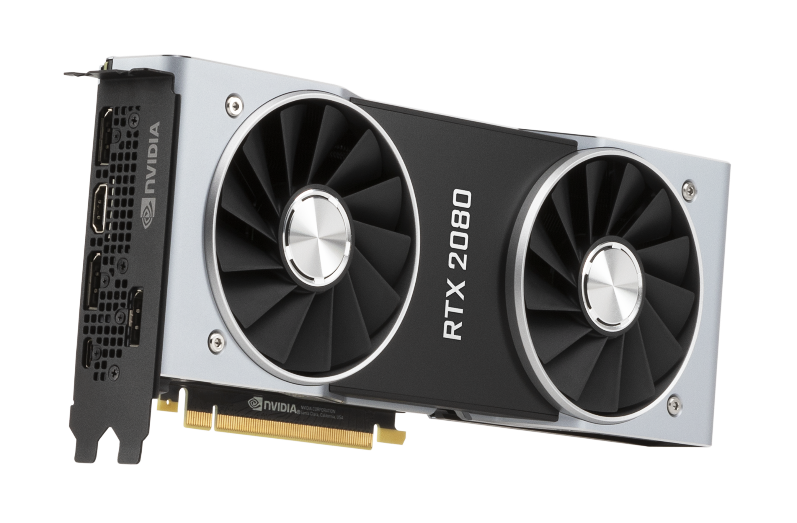
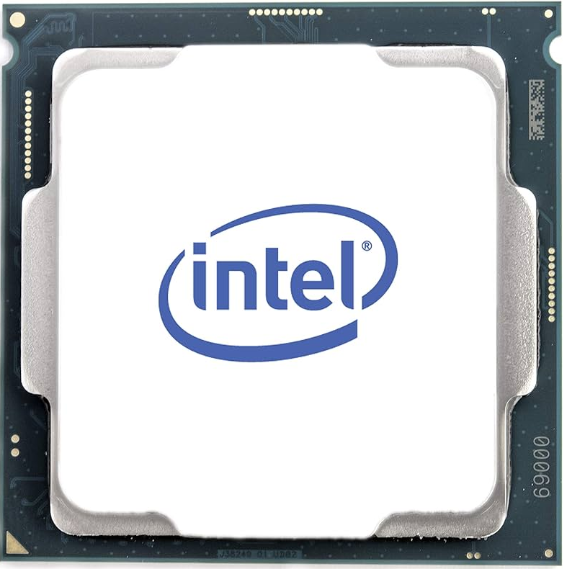
Don’t assume, always benchmark!
Thank you!
Any questions?
Illustration credit: The Tortoise and the Hare, ''The Aesop for Children'', Public Domain
Notes:
The promise of direct GPU to GPU communication sounds great, avoiding unnecessary data copies should be faster, but that wasn’t the case for us in practice.
GPUs are capable of doing many tasks faster than CPUs, but it’s important not to assume that they are faster in every scenario. Always benchmark new implementations.

